Slide 1
Recap: how to take an action
To maximize cumulative reward in future
  Value function
    State-action value
    State value $v_{π}\left(s_{t}\right)=E_{a_{t}∼π(s_{t})}\left[v_{π}(s_{t},a_{t})\right]$
  Goal: choose an action that leads to a highest value state
$$o_{1},a_{1},r_{1},o_{2},a_{2},r_{2},……,o_{t},a_{t},r_{t},o_{t+1},a_{t+1},r_{t+1},……,o_{T},a_{T},r_{T}$$
History
$$s_{t}$$
Future
$$v_{π}\left(s_{t},a_{t}\right)=E_{π}\left[\sum_{i=t}^{T}{γ^{i−t}r_{i}^{}}\right]$$
Oftentimes approximation is needed
With respect to a particular policy!
$$γ∈(0,1]$$
Why do we need this?

Slide 2
Recap: prediction vs. control
Prediction
  Evaluate value function given a policy
Control
  Optimize policy
Sort of E-step vs., M-step?
$$v\left(g\right)=−2$$
$$v\left(t\right)=0$$
$$v\left(d\right)=−4$$
2
g
2
1
t
b
d
Found a way to improve current policy
4
$$v\left(b\right)=−5$$
4
2
$$v\left(a\right)=−10.6$$
a
4
9
f
2
c
e
5
$$v\left(f\right)=0.5×\left(−2\right)+0.5×\left(−4−2\right)=−4$$
3
$$v\left(e\right)=−9$$
$$v\left(c\right)=−10.3$$
w.r.t. a uniformly random policy

Slide 3
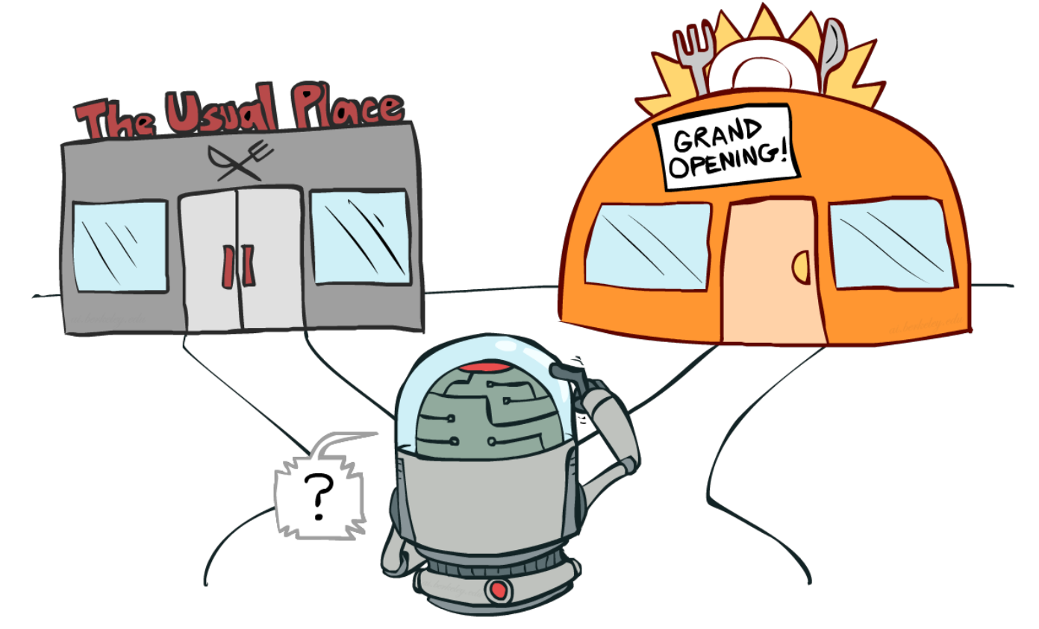
Multi-Armed Bandits
Hongning Wang
CS@THU

Slide 4
Outline
Problem formulation
Classical exploration strategies
Advanced bandit problems
Beyond our textbook!

Slide 5


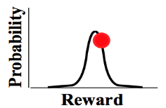
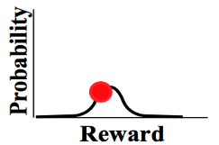
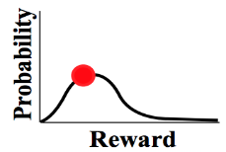


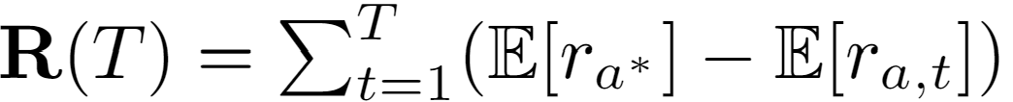





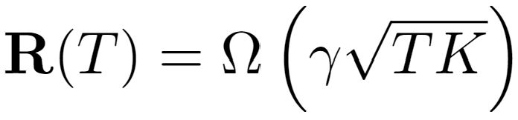

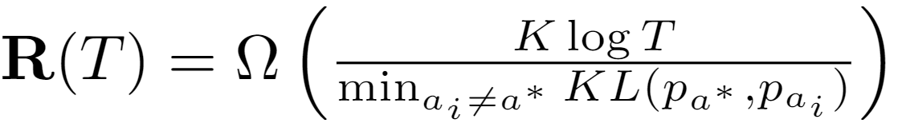
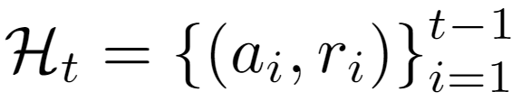
Problem formulation
https://su-my.github.io/Test-page/
Adversarial bandit is out of scope of this lecture
(stochastic) Multi-arm bandit
…
Goal: maximize the accumulated reward over T rounds
Reward distribution
(Pseudo) Regret: expected loss due to not playing the best arm
…
Actions
Regret
Agent/learner/policy
Reward
Lower regret bound [LR85]:
Lower regret bound [Aue95]:
Time
History
Finite variance is required!
Sub-linear regret is preferred!
Difficulty of the problem

Slide 6

Discussion
Why is multi-armed bandit problem difficult?
  Explore-exploit dilemma

Slide 7


Discussion
Create a multi-armed bandit problem where a greedy algorithm fails
Why is exploration necessary?
How to perform exploration?
How to balance it with exploitation?

Slide 8
Classical exploration strategies
Random exploration
Optimism in the face of uncertainty
Posterior sampling
Perturbation-based

Slide 9

Warning
A lot of math
Turbulence ahead!

Slide 10

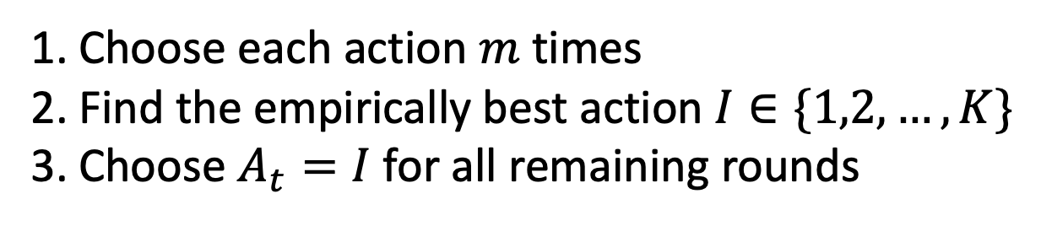
Random exploration
Explore-then-commit
What’s the probability we made a WRONG choice here?
Choose each action $m$ times
Find the empirically best action $I∈\{1,2,…,K\}$
Choose $A_{t}=I$ for all remaining rounds
Regret?

Slide 11
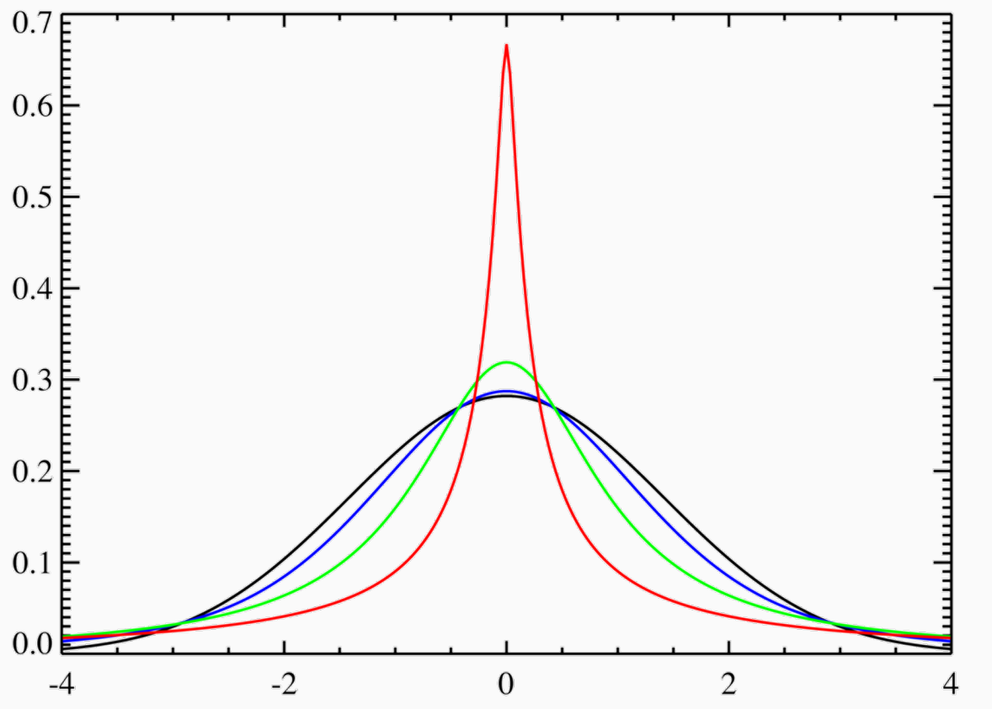
Key secret: tail bounds
How far can a random variable get away from its expectation?
  As far as it can?
  But how about its corresponding
  probability of hitting this several
  times?
Key: finite variance

Slide 12
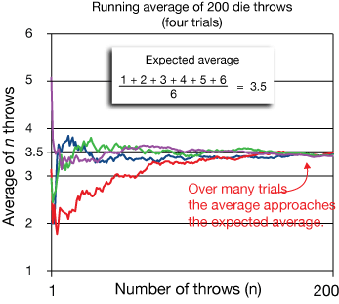
Tail bounds
Law of large numbers
  The average is approaching the expected value, when the number of trials is large

Slide 13
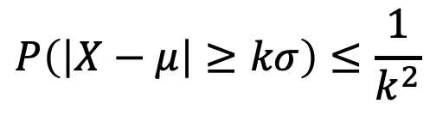
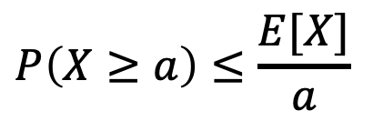
Bounding the probabilities
Markov’s inequality bounds the probability that a non-negative random variable exceeds a fixed value
Chebyshev’s inequality bounds the probability that a random variable deviates from its expected value by more than a fixed scaling of its standard deviation
$$P\left(X≥a\right)≤\frac{E[X]}{a}$$
$$P\left(\left|X−μ\right|≥kσ\right)≤\frac{1}{k^{2}}$$

Slide 14
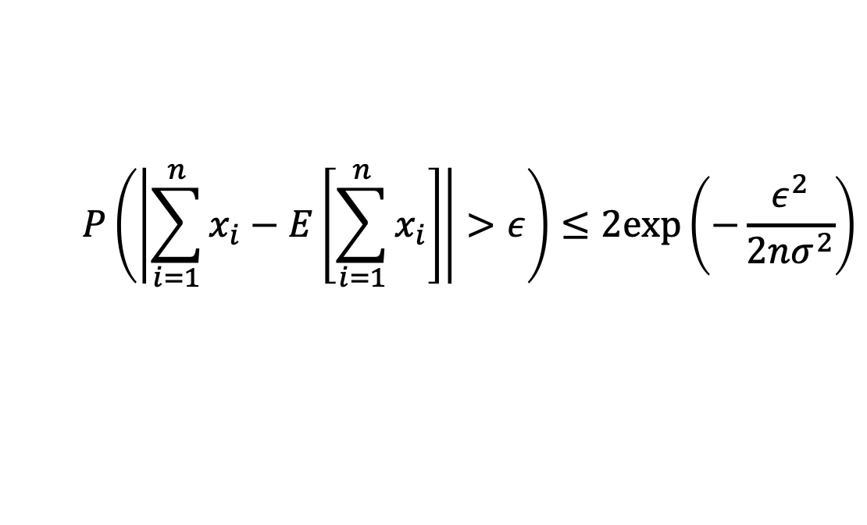
Hoeffding’s inequality
It bounds the sum of random variables deviates from its expected sum
${\left\{x_{i}\right\}}_{i=1}^{n}$ are iid random variables with finite variance $σ^{2}$
$$P\left(\left|\sum_{i=1}^{n}{x_{i}}−E\left[\sum_{i=1}^{n}{x_{i}}\right]\right|>ε\right)≤2exp\left(−\frac{ε^{2}}{2nσ^{2}}\right)$$
The probability increases slowly with respect to the number of samples!

Slide 15


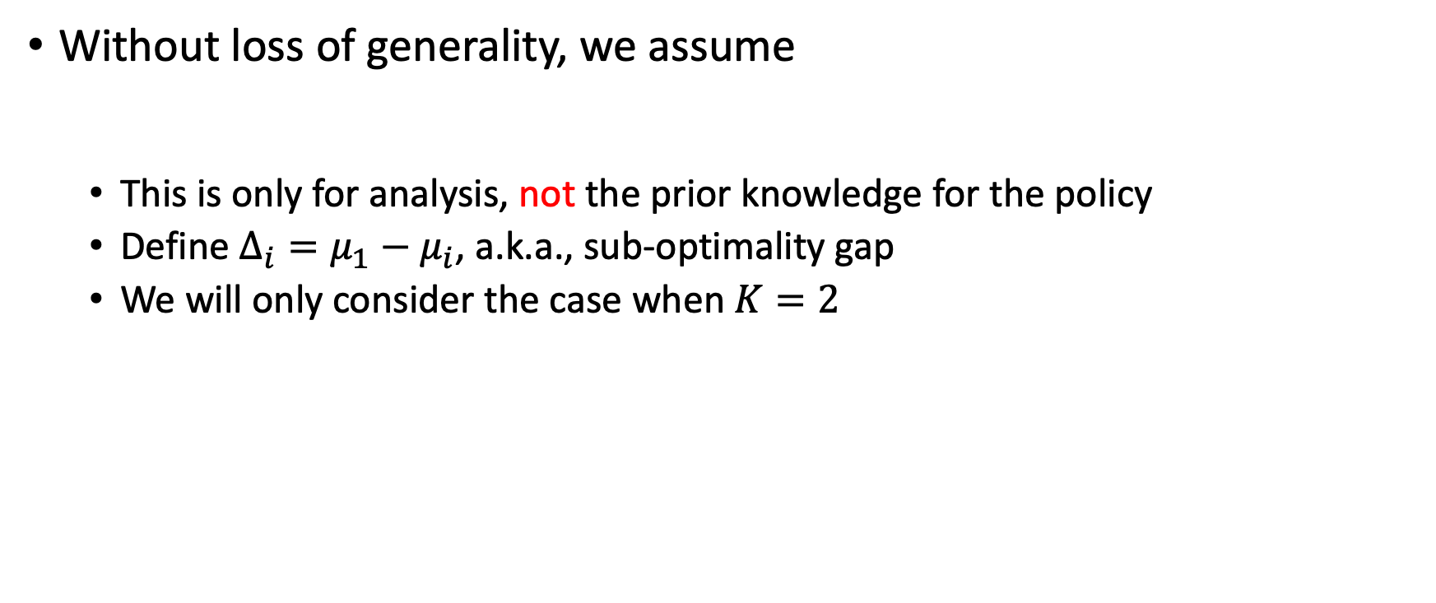
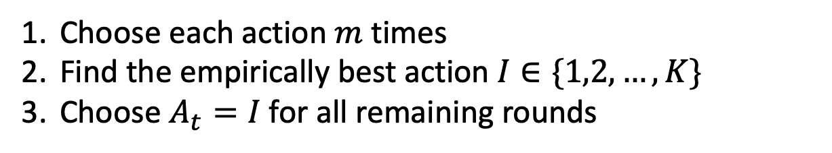
Regret analysis for explore-then-commit
Without loss of generality, we assume
  This is only for analysis, not the prior knowledge for the policy
  Define $Δ_{i}=μ_{1}−μ_{i}$, a.k.a., sub-optimality gap
  We will only consider the case when $K=2$
$$μ_{1}≥μ_{2}≥…≥μ_{K}$$
Recall the algorithm:
Choose each action $m$ times
Find the empirically best action $I∈\{1,2,…,K\}$
Choose $A_{t}=I$ for all remaining rounds
Probability of committing to the wrong arm?

Slide 16

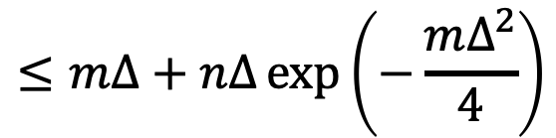
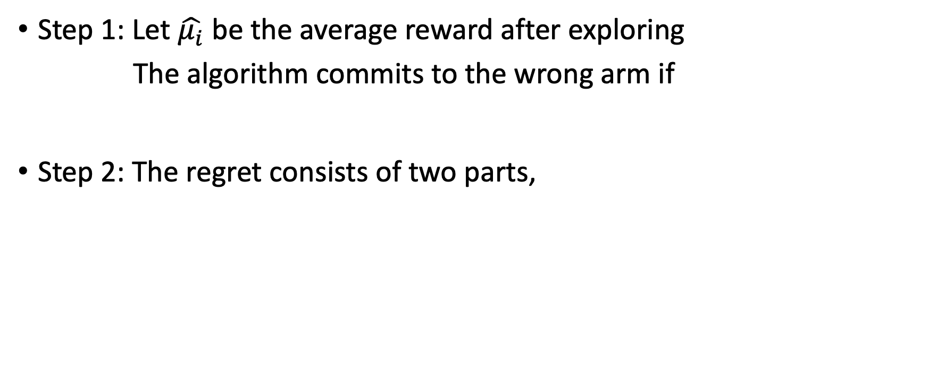
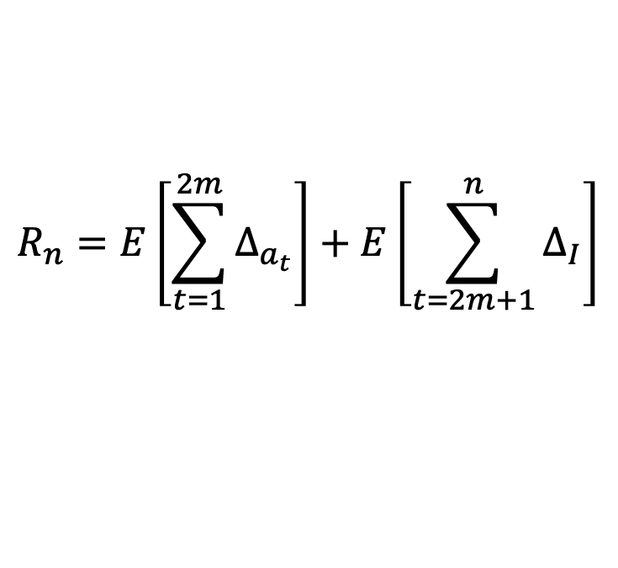
Regret analysis for explore-then-commit
Step 1: Let $\hat{μ_{i}}$ be the average reward after exploring
The algorithm commits to the wrong arm if
Step 2: The regret consists of two parts,
How likely will it happen?
$${\hat{μ}}_{2}≥{\hat{μ}}_{1}$$
$$⇔{\hat{μ}}_{2}−μ_{2}+μ_{1}−{\hat{μ}}_{1}≥Δ$$
From exploration
$$R_{n}=E\left[\sum_{t=1}^{2m}{Δ_{a_{t}}}\right]+E\left[\sum_{t=2m+1}^{n}{Δ_{I}}\right]$$
From the commitment
$$=mΔ+\left(n−2m\right)Δ×P\left(commit to the wrong arm\right)$$
$$=mΔ+\left(n−2m\right)Δ×P\left({\hat{μ}}_{2}−μ_{2}+μ_{1}−{\hat{μ}}_{1}≥Δ\right)$$
$$≤mΔ+nΔ\exp\left(−\frac{mΔ^{2}}{4}\right)$$
Hoeffding!

Slide 17
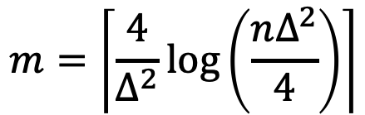
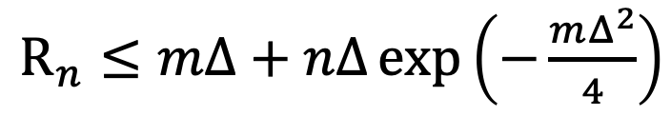
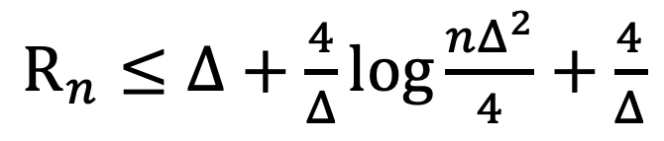
Explore-exploit dilemma
Let’s take a close look at the regret
  When is the right-hand side minimized?
  This gives us its regret bound
$R_{n}≤mΔ+nΔ\exp\left(−\frac{mΔ^{2}}{4}\right)$
Cost of exploration
Benefit of exploration
$$m=\left\lceil \frac{4}{Δ^{2}}\log\left(\frac{nΔ^{2}}{4}\right)\right\rceil$$
Looks nice!
$R_{n}≤Δ+\frac{4}{Δ}\log{\frac{nΔ^{2}}{4}}+\frac{4}{Δ}$

Slide 18
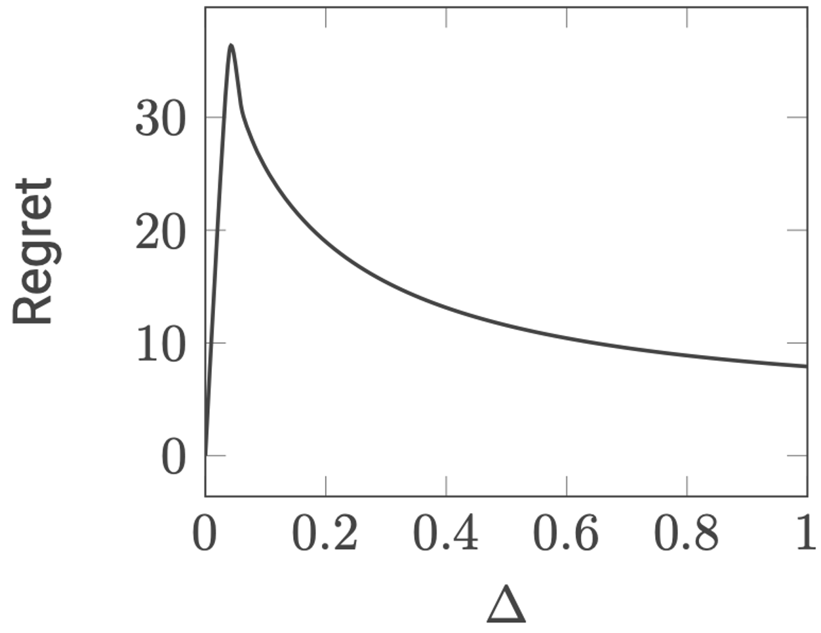
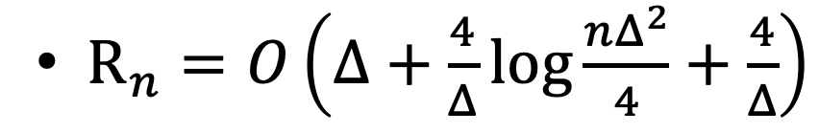
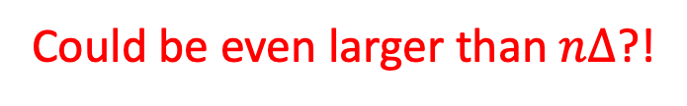
What makes the problem difficult?
$R_{n}=O\left(Δ+\frac{4}{Δ}\log{\frac{nΔ^{2}}{4}}+\frac{4}{Δ}\right)$
Could be even larger than $nΔ$?!

Slide 19
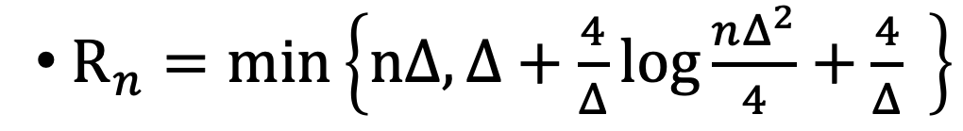
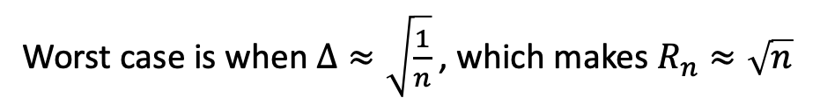
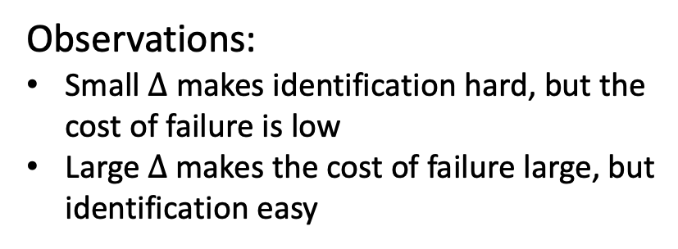
What makes the problem difficult?
$R_{n}=min\left\{nΔ,Δ+\frac{4}{Δ}\log{\frac{nΔ^{2}}{4}}+\frac{4}{Δ} \right\}$
Observations:
Small $Δ$ makes identification hard, but the cost of failure is low
Large $Δ$ makes the cost of failure large, but identification easy
Worst case is when $Δ≈\sqrt{\frac{1}{n}}$ , which makes $R_{n}≈\sqrt{n}$

Slide 20
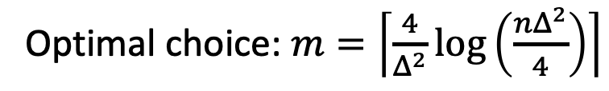
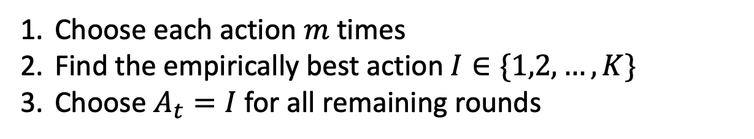


Limitations
Needs prior knowledge of $n$ and $Δ$
Optimal choice: $m=\left\lceil \frac{4}{Δ^{2}}\log\left(\frac{nΔ^{2}}{4}\right)\right\rceil$
Recall the algorithm:
Choose each action $m$ times
Find the empirically best action $I∈\{1,2,…,K\}$
Choose $A_{t}=I$ for all remaining rounds
Regret $R_{n}=min\left\{nΔ,Δ+\frac{4}{Δ}\log{\frac{nΔ^{2}}{4}}+\frac{4}{Δ} \right\}$
Empirically, all variants of it are at least a factor of 2 from the optimal regret

Slide 21

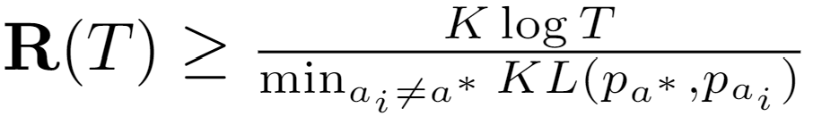

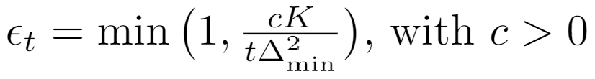





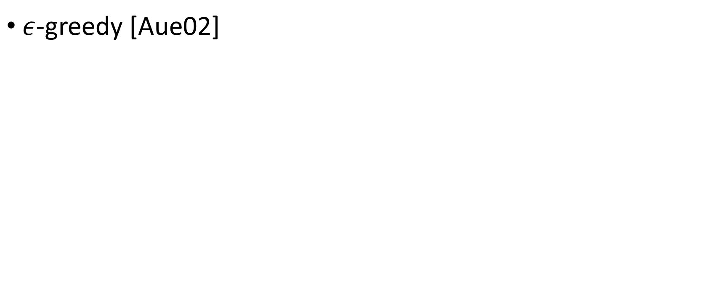
Random exploration
Lower regret bound of MAB:
Constant leads to linear regret!
$ε$-greedy [Aue02]
By setting , we have
Arm selection
Non-adaptive; often leads to sub-optimal performance in practice!

Slide 22

Optimism principle
It is also an important principle in online decision making!

Slide 23
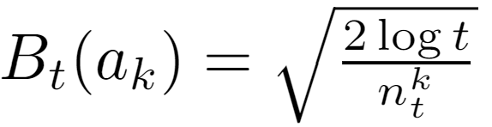



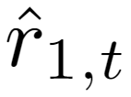
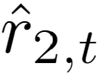

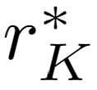

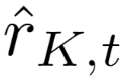
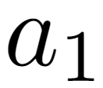



Optimism in the face of uncertainty
UCB1 [Aue02]
  Upper confidence bound: with high probability, the true reward falls under it
The largest “true” reward it possibly could have
Reward
Encourage underestimated arms
…

Slide 24

Regret of UCB: 2-arm version
Empirical mean
True mean
We will keep pulling this arm until?
Reward
$$Δ$$

Slide 25
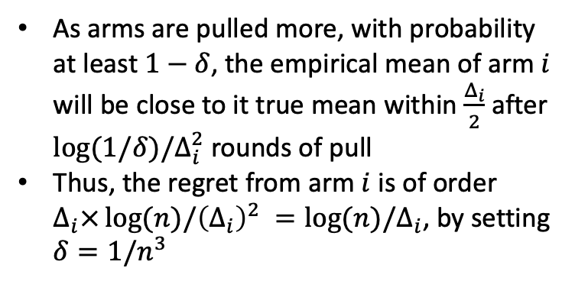
Regret of UCB (proof sketch)
As arms are pulled more, with probability at least $1−δ$, the empirical mean of arm $i$ will be close to it true mean within $\frac{Δ_{i}}{2}$ after $\log{(1/δ)/Δ_{i}^{2}}$ rounds of pull
Thus, the regret from arm $i$ is of order $Δ_{i}×\log{(n)/{\left(Δ_{i}\right)}^{2} }=\log{(n)/Δ_{i}}$, by setting $δ=1/n^{3}$
Empirical mean
True mean
Reward
$$Δ$$

Slide 26
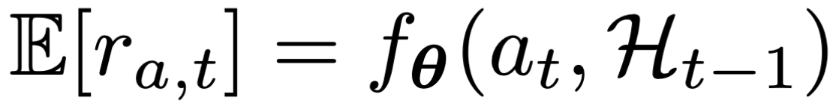


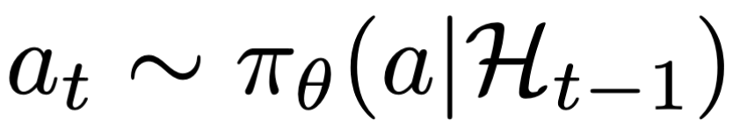


Using the language of RL
Problem formulation
A simplified RL problem!
State
Reward
Action

Slide 27

Let’s get into the real world
Warning: severe storm ahead!

Slide 28











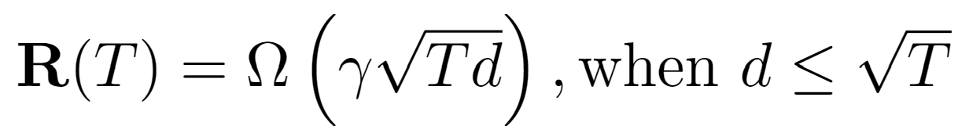
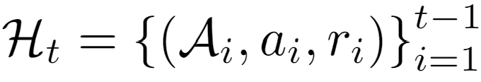
Problem formulation
In linear contextual bandit [LCLS10],
Contextual/structured bandit
…
Goal: maximize the accumulated reward over T rounds
Reward distribution
(Pseudo) Regret: expected loss due to not playing the best arm
…
Actions
Agent/learner/policy
Reward
Lower regret bound in linear contextual bandit [CLRS11]:
History

Slide 29
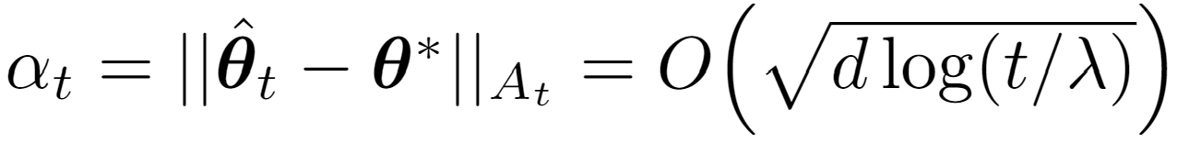
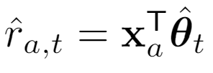
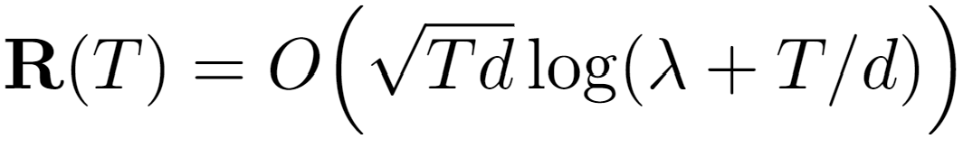
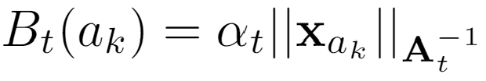
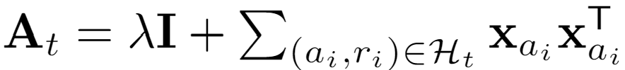


Optimism in the face of uncertainty
Lower regret bound in linear contextual bandit [CLRS11]:
In linear contextual bandit,
LinUCB [LCLS10]
  Upper confidence bound based
Confidence ellipsoid
Reward
Encourage underestimated arms
…
Closed form estimator

Slide 30
Recap: problem formulation
Adversarial bandit is out of scope of this lecture
(stochastic) Multi-arm bandit
…
Goal: maximize the accumulated reward over T rounds
Reward distribution
(Pseudo) Regret: expected loss due to not playing the best arm
…
Actions
Regret
Agent/learner/policy
Reward
Lower regret bound [Aue95]:
Time
History
Sub-linear regret is preferred!
Difficulty of the problem

Slide 31
Recap: regret analysis for explore-then-commit
Step 1: Let $\hat{μ_{i}}$ be the average reward after exploring
The algorithm commits to the wrong arm if
Step 2: The regret consists of two parts,
How likely will it happen?
$${\hat{μ}}_{2}≥{\hat{μ}}_{1}$$
$$⇔{\hat{μ}}_{2}−μ_{2}+μ_{1}−{\hat{μ}}_{1}≥Δ$$
From exploration
$$R_{n}=E\left[\sum_{t=1}^{2m}{Δ_{a_{t}}}\right]+E\left[\sum_{t=2m+1}^{n}{Δ_{I}}\right]$$
From the commitment
$$=mΔ+\left(n−2m\right)Δ×P\left(commit to the wrong arm\right)$$
$$=mΔ+\left(n−2m\right)Δ×P\left({\hat{μ}}_{2}−μ_{2}+μ_{1}−{\hat{μ}}_{1}≥Δ\right)$$
$$≤mΔ+nΔ\exp\left(−\frac{mΔ^{2}}{4}\right)$$
Hoeffding!

Slide 32
Recap: optimism in the face of uncertainty
UCB1 [Aue02]
  Upper confidence bound: with high probability, the true reward falls under it
The largest “true” reward it possibly could have
Reward
Encourage underestimated arms
…

Slide 33
Recap: optimism in the face of uncertainty
LinUCB [LCLS10]
  Upper confidence bound based
In linear contextual bandit,
Reward
Encourage underestimated arms
…
Closed form estimator

Slide 34
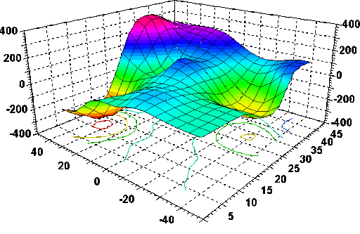



Visualization of contextual bandits
$$x_{3}$$
$$x_{1}$$
$$x_{2}$$

Slide 35



General problem formulation
In linear contextual bandit [LCLS10],
Key problems
  Reward estimation
  Arm selection
Ridge regression, closed form solution exists!
Reward
Action
Convergence matters!
Exploration matters!
Multi-arm bandit:
Contextual bandit:
Adaptive v.s., non-adaptive
Independent v.s., collaborative
Unconstrained v.s., constrained
Loss function Regularization

Slide 36







Posterior sampling
In linear contextual bandit [LCLS10],
Predictive distribution:
Thompson sampling [AG13]
Source of uncertainty
A Bayesian perspective of reward estimation:
prior
related to prior
Reward
…
Analytic form of posterior
Prior:

Slide 37



Perturbation-based
1) Concentrates at a scaled and shifted mean reward;
2) It is an overestimation with a high probability.
Perturbed history exploration [KSGB19a]
Encourage underestimated arms
Reward
Encourage underestimated arms
…
…

Slide 38




Perturbation-based
1) Concentrates at a scaled and shifted mean reward;
2) It is an overestimation with a high probability.
Perturbed history exploration [KSGB19b]
    With a linear model?
Closed form estimator
00
Reward
…
…
Added reward variance

Slide 39
Advanced bandit problems
Collaborative bandits
Non-stationary bandits
Fair bandit learning

Slide 40
A design question
How do we formulate the problem of recommendation as a bandit problem?
  Setting: recommending K items to N users
  What are the arms?
  What’s the reward?

Slide 41








Collaborative bandit learning
$N$ users, each user has his/her own $θ$
  Build independent LinUCB for each user?
  Cold start challenge in personalized systems
  Users are not independent
Leverage user dependency for efficient exploration
  Use existing user dependency information
  Discover dependency online (via clustering)

Slide 42



Online clustering
Remove edge if
CLUB[GLZ14]
  Adaptively cluster users into groups
  Threshold to remove edges is based on closeness of the users’ models
  Build LinUCB on each cluster
Regret: . Reduce regret from N (users) to m (clusters)
Closed form estimator

Slide 43


Fairness concerns
Machine bias – an important topic in machine learning
  Research of bias in data, model, algorithm etc.
    E.g., discriminatory treatment of subpopulations
  The need to explore
Fairness guarantee during online decision making (bandits)
How to define fairness in bandit learning?

Slide 44

FairUCB [JKMR16]
Idea: uniformly pull arm within the first confidence interval chain
  Start from the largest UCB, find overlapped confidence intervals
Guaranteed fairness at every step with high probability
Regret:
Fairness requirement: if arm a is truly better than b, the frequency we pull a should not be lower than b.
Reward
…

Slide 45
Takeaways
Efficiency matters in exploration
Various perspectives to perform exploration
  Confidence interval
  Posterior distribution
  Perturbation based
New challenges in bandit learning

Slide 46
References I
[SSSCJ16] Schnabel, T., Swaminathan, A., Singh, A., Chandak, N., & Joachims, T. (2016, June). Recommendations as treatments: debiasing learning and evaluation. In Proceedings of the 33rd International Conference on International Conference on Machine Learning-Volume 48 (pp. 1670-1679).
[LR85] Lai, T. L., & Robbins, H. (1985). Asymptotically efficient adaptive allocation rules. Advances in applied mathematics, 6(1), 4-22.
[Aue95] Auer, P., Cesa-Bianchi, N., Freund, Y., & Schapire, R. E. (1995, October). Gambling in a rigged casino: The adversarial multi-armed bandit problem. In Proceedings of IEEE 36th Annual Foundations of Computer Science (pp. 322-331). IEEE.
[LCLS10] Li, L., Chu, W., Langford, J., & Schapire, R. E. (2010, April). A contextual-bandit approach to personalized news article recommendation. In Proceedings of the 19th international conference on World wide web (pp. 661-670).
[CLRS11] Chu, W., Li, L., Reyzin, L., & Schapire, R. (2011, June). Contextual bandits with linear payoff functions. In Proceedings of the Fourteenth International Conference on Artificial Intelligence and Statistics (pp. 208-214).
[SB18] Sutton, R. S., & Barto, A. G. (2018). Reinforcement learning: An introduction. MIT press.
[Aue02] Auer, P. (2002). Using confidence bounds for exploitation-exploration trade-offs. Journal of Machine Learning Research, 3(Nov), 397-422.
[LZ08] Langford, J., & Zhang, T. (2008). The epoch-greedy algorithm for multi-armed bandits with side information. In Advances in neural information processing systems (pp. 817-824).
[FCGS10] Filippi, S., Cappe, O., Garivier, A., & Szepesvári, C. (2010). Parametric bandits: The generalized linear case. In Advances in Neural Information Processing Systems (pp. 586-594).
[GC11] Garivier, A., & Cappé, O. (2011, December). The KL-UCB algorithm for bounded stochastic bandits and beyond. In Proceedings of the 24th annual conference on learning theory (pp. 359-376).

Slide 47
References II
[AG13] Agrawal, S., & Goyal, N. (2013, February). Thompson sampling for contextual bandits with linear payoffs. In International Conference on Machine Learning (pp. 127-135).
[RVKOW18] Russo, D. J., Van Roy, B., Kazerouni, A., Osband, I., & Wen, Z. (2018). A Tutorial on Thompson Sampling. Foundations and Trends® in Machine Learning, 11(1), 1-96.
[KSGB19a] Kveton, B., Szepesvári, C., Ghavamzadeh, M., & Boutilier, C. (2019, August). Perturbed-history exploration in stochastic multi-armed bandits. In Proceedings of the 28th International Joint Conference on Artificial Intelligence (pp. 2786-2793). AAAI Press.
[KSGB19b] Kveton, B., Szepesvari, C., Ghavamzadeh, M., & Boutilier, C. (2019). Perturbed-history exploration in stochastic linear bandits. arXiv preprint arXiv:1903.09132.
[KMRWW18] Kannan, S., Morgenstern, J. H., Roth, A., Waggoner, B., & Wu, Z. S. (2018). A smoothed analysis of the greedy algorithm for the linear contextual bandit problem. In Advances in Neural Information Processing Systems (pp. 2227-2236).
[CGZ13] Cesa-Bianchi, N., Gentile, C., & Zappella, G. (2013). A gang of bandits. In Advances in Neural Information Processing Systems (pp. 737-745).
[WWGW16] Wu, Q., Wang, H., Gu, Q., & Wang, H. (2016, July). Contextual bandits in a collaborative environment. In Proceedings of the 39th International ACM SIGIR conference on Research and Development in Information Retrieval (pp. 529-538).
[GLZ14] Gentile, C., Li, S., & Zappella, G. (2014, January). Online clustering of bandits. In International Conference on Machine Learning (pp. 757-765).

Slide 48
References III
[WNW18] Wu, Q., Iyer, N., & Wang, H. (2018, June). Learning contextual bandits in a non-stationary environment. In The 41st International ACM SIGIR Conference on Research & Development in Information Retrieval (pp. 495-504).
[WWLW19] Wu, Q., Wang, H., Li, Y., & Wang, H. (2019, May). Dynamic Ensemble of Contextual Bandits to Satisfy Users' Changing Interests. In The World Wide Web Conference (pp. 2080-2090).
[JKMNR16] Joseph, M., Kearns, M., Morgenstern, J., Neel, S., & Roth, A. (2016). Fair algorithms for infinite and contextual bandits. arXiv preprint arXiv:1610.09559.

Slide 49




Random exploration
Reward estimation in MAB:
Epoch greedy [LZ08]
  A variant of explore then commit
Explore by one step
Size of hypothesis space, which makes the exploration adaptive
Length of epoch
Exploit by one epoch

Slide 50


















Collaborative bandit learning
CoLin [WWGW16]
  Social influence among users: content and opinion sharing in social network $W$
  Reward: weighted average of expected reward among friends
  A dN-dimensional LinUCB
in which
Closed form estimator
When $W$ is uniform, i.e, all users are uniformly connected to share:
Regret:
0.6 | 0.1 | 0.2 | 0.0
0.0 | 0.7 | 0.0 | 0.0
0.0 | 0.1 | 0.8 | 0.5
0.4 | 0.1 | 0.0 | 0.5

Slide 51



Non-stationary bandits
Problem formulation
Non-stationary
…
…
Reward distribution
…
Real-time click-through-rate of 4 news articles collected from Yahoo user click log dataset
Actions
What’s the deal?
I need to be adaptive about potential changes in the environment
☹
Agent/learner/policy
Reward
☺
Regret
History is no longer helpful and may even be misleading in the player’s decision-making
Time

Slide 52















Non-stationarity
  Different types of non-stationary environments
    Piecewise stationary environments
    Gradually changing environments
What should we do?
Key: how to detect the change?
More difficult and less studied.
Expected Reward
Expected Reward
Time
Time

Slide 53


CB based online change detection
Utilize the reward estimation confidence [WNW18, WWLW19]
  If the environment is stationary, the reward prediction residual should be within a confidence interval with high probability
Predicted reward of bandit model m
Observed reward
Confidence bound of reward estimation
We can bound this to further exclude this possibility!
Unexpected outcome is caused by,
Something wrong in the observed reward: large noise
Something wrong in the predicted reward: the model is incorrect

Slide 54










CB based online change detection
dLinUCB [WNW18]
Adaptively creates new learners
Monitors the prediction quality of each learner
Selects a learner according to each learner’s ‘badness’
.
.
…
badness
badness
Badness estimation update
Reward estimation update
…
…

